Slide 1
Work(place) Evolution
Hybrid Work and Communication Toolkit
Team Norms Discussion

Slide 2
We have designed this slide deck to align with the menu of exercises you can consider doing with your team during the Team Norms Discussion.
When you have selected the activities and discussion questions you want to use, customize this slide deck to fit your needs by deleting slides you do not want to use.
In addition to customizing which slides you use, you will also need to customize some text within the slides. While some slides can be used as is, those marked with ‘Customize this slide’ or ‘Customize your approach’ need to be edited to suit your preferences, approach, and/or specific team context.
Using the slides
Customize your approach!
Customize this slide!

Slide 3
Agenda (X mins)*
INTROS & WARM-UP (X mins)
Activity 1
Activity 2
Activity 3
HYBRID TEAM NORM GENERATION (X mins) Discussion question 1
Discussion question 2
Discussion question 3
BREAK (X mins)
HYBRID NORMS CHECKLIST (X mins) Complete Team Norms Checklist
WRAP-UP (X mins)
Set date to check-in and
share feedback
Customize your approach!

Slide 4
Customize this slide!
Intros & Warm-Up
(X minutes)

Slide 5
Warm-Up Question:
Introduce yourself
Your name
Your role on the team
What you’re most looking forward to or interested to get out of today’s discussion

Slide 6
Warm-Up Question:
Write down a fact about yourself
Each person will write down a unique fact about themselves, and we will try to match the facts to the people.

Slide 7
Warm-Up Question:
Send everyone a bingo sheet ahead of time
Customize this slide!
B | I | N | G | O
Has a pet | First or second generation immigrant | Knows their Myers Briggs (or other) type | Did or do volunteer work | Visited a UNESCO heritage site
Regularly reads more than 3 books a year | Had stitches | Failed a class | Climbed a mountain | More than 1 sibling
Broken a bone | Plays an instrument |  | Travelled to at least ½ of the world’s continents | Can name 7 countries that start with U
Wears glasses or contacts | Flown on a plane in the past 2 years | Won a trophy | Speaks more than 1 language | Been to all 10 Canadian provinces
Been to any Canadian territory | Is left handed | Is an artist (don't be modest) | Been scuba diving | Is an only child
Bingo!

Slide 8
Warm-Up Question:
Team strengths:
EXAMPLE:
Asking for help
What are our strengths, as a team and as individuals?
Individual strengths:
EXAMPLE:
Michelle -
Rallying people

Slide 9
Warm-Up Question:
EXAMPLE:
Meera is the best person to reach out to when I’m struggling with a summarizing complex information.
What do you enjoy most about working on this team?
EXAMPLE:
Michelle always knows how to help me solve my tech challenges!

Slide 10
Warm-Up Question:
EXAMPLE:
Completed X project
What have been our team’s biggest successes in the past year
EXAMPLE: Presented at X conference

Slide 11
Meeting etiquette
Customize this slide!
Honour confidentiality
Assume positive intent
Seek to understand
Be curious
Be present & engaged (no multi-tasking)
Be honest & speak your mind – this is a safe space
Use real examples to root observations in reality
Be open to a final outcome we might not have anticipated
Any other suggestions?
In this meeting, we will…

Slide 12
Goals
Customize this slide!
Identify what we value and what we don’t enjoy about being in the office. Identify ways to prioritize the good things and mitigate the challenges.
Identify which days we will be on campus, and what activities we will prioritize when we are together.
Identify activities we can do as a group, virtually and in-person, to support team building and relationship building
Identify when and how we will use communication tools (email, Teams direct messages, phone, text) to communicate
Identify the hybrid practices we’ve evolved in the last 3 years that are working well, and those that are not working well
A date when we will check in to see how things are going
In this meeting, we will…

Slide 13
Customize this slide!
Hybrid Team Norm Generation
(X minutes)

Slide 14
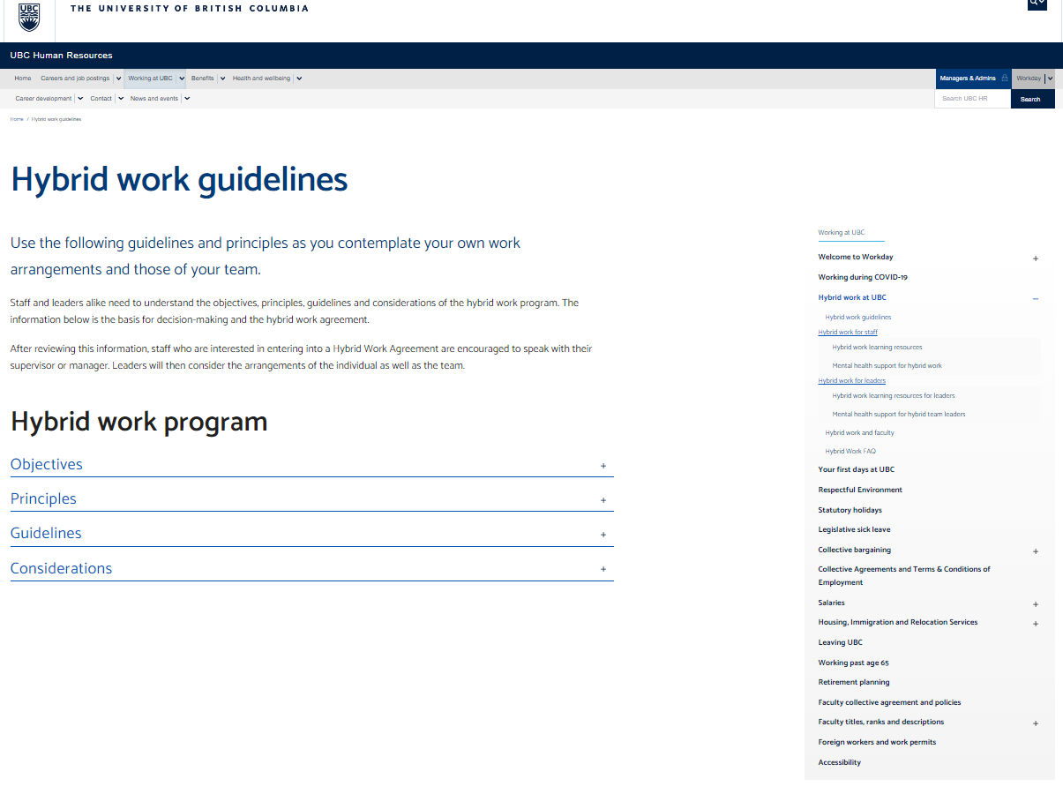
Define:
UBC policy states that 100% remote work arrangements will not be considered at this time
At minimum, all UBC employees are required to be on campus 20% of the time
Context
https://hr.ubc.ca/hybrid-work-guidelines

Slide 15
Define:
Objectives of the hybrid work program are to:
Attract and retain staff by creating a more flexible workplace environment.
Positively impact student experience and outcomes through flexibility and the use of technology.
Optimize service levels, work quality, and productivity through flexibility and the use of technology.
Reduce carbon emissions through lower levels of commuting and strain on campus facilities.
Catalyze collaboration between UBC and its partners through normalizing remote interactions.
Promote and enable connections and balance across UBC campuses.
UBC Hybrid
Work Guidelines Overview

Slide 16
Define:
Principles—Decisions regarding hybrid work arrangements must:
Prioritize the physical and mental health of students, faculty, and staff.
Promote the academic mission of the university, respecting faculty commitments to research, teaching, and service.
Centre around student experience and outcomes.
Respect and reflect the importance of diversity, equity, and inclusion.
Sustain or improve service levels, quality of work, and productivity.
Protect culture, team dynamics, and the potential for creativity, innovation, and collaboration.
Maintain the vibrancy of our campuses and learning sites.
Optimize space utilization and consider financial sustainability.
Uphold the autonomy of units and teams in determining their work arrangements in alignment with the guidelines and other principles of the program.
Support an institutional approach and consistency in application, maintaining agility to pivot if and as required.
UBC Hybrid
Work Guidelines Overview

Slide 17
Define:
Customize this slide!
The following elements of the UBC Hybrid Guidelines are relevant for our team:
Prioritize physical and mental health
Sustain or improve service levels, quality of work, and productivity.
Protect culture, team dynamics, and the potential for creativity, innovation, and collaboration.
Current hybrid work arrangements for our team:
Our anchor day(s) is/are:
We are coming in x days a week
New staff may be asked to come in more often to start
The whole team may be asked to come in more often when we are onboarding a new team member
How our team will approach hybrid work

Slide 18
Define:
EXAMPLE:
Socializing with colleagues
What makes coming in to the office meaningful for you?
EXAMPLE:
Getting a break from kids/pets at home

Slide 19
Define:
EXAMPLE:
When I have lots of Zoom meetings
What makes coming in to the office less meaningful for you?
EXAMPLE:
When there is no one else around

Slide 20
Define:
Roses, Buds, & Thorns
Think about our current hybrid work norms & culture.
ROSES:
What’s going well?
BUDS:
What’s an emerging opportunity?
THORNS:
What are the painful challenges?

Slide 21
ROSES:
What’s going well:
BUDS:
Emerging opportunities:
THORNS:
Painful challenges:

Slide 22
Define:
In the office:
EXAMPLE:
Team meetings
What activities do we want to prioritize when we are in the office vs. when we are at home?
EXAMPLE:
Collaborative work
At home
EXAMPLE:
Focused work
EXAMPLE:
Zoom meetings

Slide 23
Define:
EXAMPLE:
Team meetings
In-person
What format will we choose for different kinds of meetings?
EXAMPLE:
1:1s
EXAMPLE:
Brainstorming
Hybrid
EXAMPLE:
Project-based discussions
Fully Remote

Slide 24
Define:
EXAMPLE:
Requesting feedback on a document
Email
What communication channels do we want to use for what purposes?
EXAMPLE:
Need to let them know you are sick
EXAMPLE:
Need an answer to an urgent question
MS Teams Message
EXAMPLE:
Want to request a meeting
EXAMPLE:
Have a quick question
EXAMPLE:
Have a non-urgent question
Text message

Slide 25
Customize this slide!
Break
(X minutes)

Slide 26
Communicate:
Onboarding new team members:
EXAMPLE:
Share the checklist
How will we share our team norms with new members? When will we revisit this discussion?
EXAMPLE:
Discuss at a team meeting
Revisit this discussion
EXAMPLE:
Lots of new team members
EXAMPLE:
We feel our approach isn’t working

Slide 27
Communicate:
Communicate working hours:
EXAMPLE:
Update MS Teams status
How will we communicate our working hours? How will we protect focus time?
EXAMPLE:
Set up a shared team calendar
Protect focus time:
EXAMPLE:
Set MS Teams status to ‘Do not disturb’
EXAMPLE:
Block off focus time in my calendar

Slide 28
Communicate:
EXAMPLE:
No multitasking
What meeting ‘hygiene’ practices do we want to adopt to make our meetings more effective and more engaging?
EXAMPLE:
Make time at the beginning of the meeting to review pre-read materials
EXAMPLE:
Video on for hybrid/virtual meetings

Slide 29
Communicate:
EXAMPLE:
In-person team meetings
How do we want to invest in team culture, team building activities, and informal ways to connect as a team?
EXAMPLE:
Monthly in-person or virtual coffee hours
EXAMPLE:
Plan to eat lunch together when onsite

Slide 30
Communicate:
EXAMPLE:
Training on how to use MS Teams
What do we need to make adoption of these hybrid work norms easier?
EXAMPLE:
More days when everyone is in the office together so coming in is “worth it”

Slide 31
Evolve
EXAMPLE:
1 team meeting per year dedicated to revisiting our norms
How will we ensure we are evolving our team norms and adapting to changes in context and new ideas?
EXAMPLE:
If more than ½ the team is new since the last Discussion, we will do it again from scratch.
EXAMPLE: Anonymous team survey to gather feedback

Slide 32
Customize this slide!
Break
(X minutes)

Slide 33
Customize this slide!
Hybrid Norms Checklist
(X minutes)

Slide 34
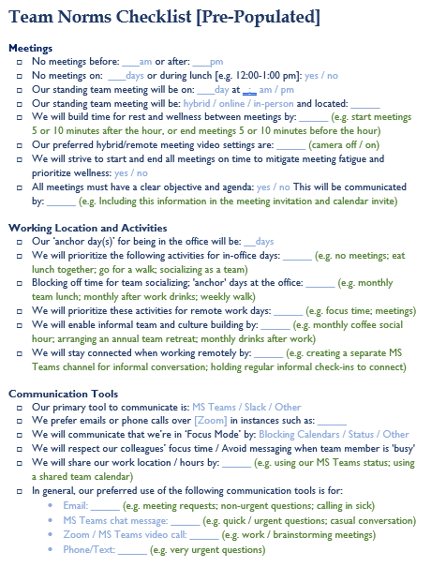
Team Norms Checklist

Slide 35
Customize this slide!
Use this slide to tell your team how you want to complete the team norms discussion. Depending on how much time you have, you may need to do a combination of approaches.
As part of the Team Norms Discussion:
You can end your Team Norms Discussion by completing the Checklist as a group. Look back at the notes you took and the ideas you generated as a team during the Team Norms Discussion.
Consolidate and revisit after the Team Norms Discussion:
One person from the team can take away the notes captured during the Team Norms Discussion and synthesize them into a Checklist that captures the team’s preferences. Schedule time in your next team meeting or a specific block of time to review the Checklist that was created and make any changes that may be necessary.
Individual homework:
Ask each person from your team to take the Checklist away to complete on their own as ‘homework’. Schedule time during your next team meeting or a specific block of time to compare each of your Checklists to come up with a single Checklist for your team.
Team Norms Checklist

Slide 36
Customize this slide!
Next Steps
(X minutes)

Slide 37
Customize this slide!
Use this slide to consider what you will do to wrap-up your team norms discussion.
What are your next steps as a team to follow-up on the decisions you have made during the Discussion?
If you have asked your team to complete the Team Norms Checklist as ‘homework’, tell them when you want their responses back and wen you will meet to discuss them.
Where will you store your Team Norms Checklist?
When will you meet again to check-in on how things are going?
Will you be following up formally or informally to gather feedback directly from the people on your team?
Are there any calendar invitations you need to send out based on decisions you made during the discussion?
Monthly casual coffee hour
In-person lunches
Annual team retreat
Wrap-up / Next steps

